Slide 1

A 3D Storyline Using Unity Game Engine
Group No. 07
Aaryan Parab 18104060
Nikhil Rathod 18104001
Tanaya Patil 18104022
Project Guide
Prof. Neha Deshmukh

Slide 2
Contents
Introduction
Objectives
Problem Definition
Technological Stack
Review Suggestions (Given in Last meeting)
Proposed System Architecture/Working
Prototype Design Demonstration
Implementation Status
Status of Paper Draft & Targeted Conference

Slide 3
1. Introduction
Problem Identified -
  Indian culture has played an important role in molding our lives. Now-a-days our new generation is steering a course towards Modernization and western culture and we can see lack of interest in Indian Culture and Mythology in our younger generation.
Solution Proposed -
  To overcome this problem we will develop 3D video game that will introduce youngsters to Indian Mythological Concepts in a interactive as well as fascinating way.

Slide 4
2. Objectives
To build a video game involving the Indian Culture.
To involved youngsters in Indian Culture in an entertaining way.
To build 3 dimensional visual world with high graphics.
To create an exciting game scenes and animations using Unity3D and After Effects.
To achieve perfect efficiency in creating 3D modelling using blender
To create ,edit and restoring audio using Auditions.

Slide 5
3. Problem Definition
The young Indians more obsessed with the latest trends of globalization.
To overcome this problem we have implemented a solution in which 3D game will be made to increase youngsters involvement in Indian culture and Mythology in an interactive as well as in fascinating way.

Slide 6
4. Technological Stack
Unity 3D : To build game scenes.
Blender/Maya : To create 3D models.
Photoshop/Illustrator : To edit the models used in game.
Audition tool : To create or edit the audio.
After Effects tool : To give an animation.

Slide 7
5. Reviews and Suggestions
To work on the title of the project.

Slide 8
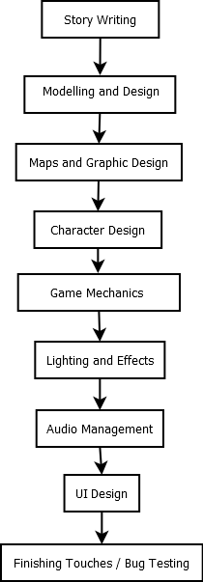
6. Proposed System Architecture/ Working

Slide 9
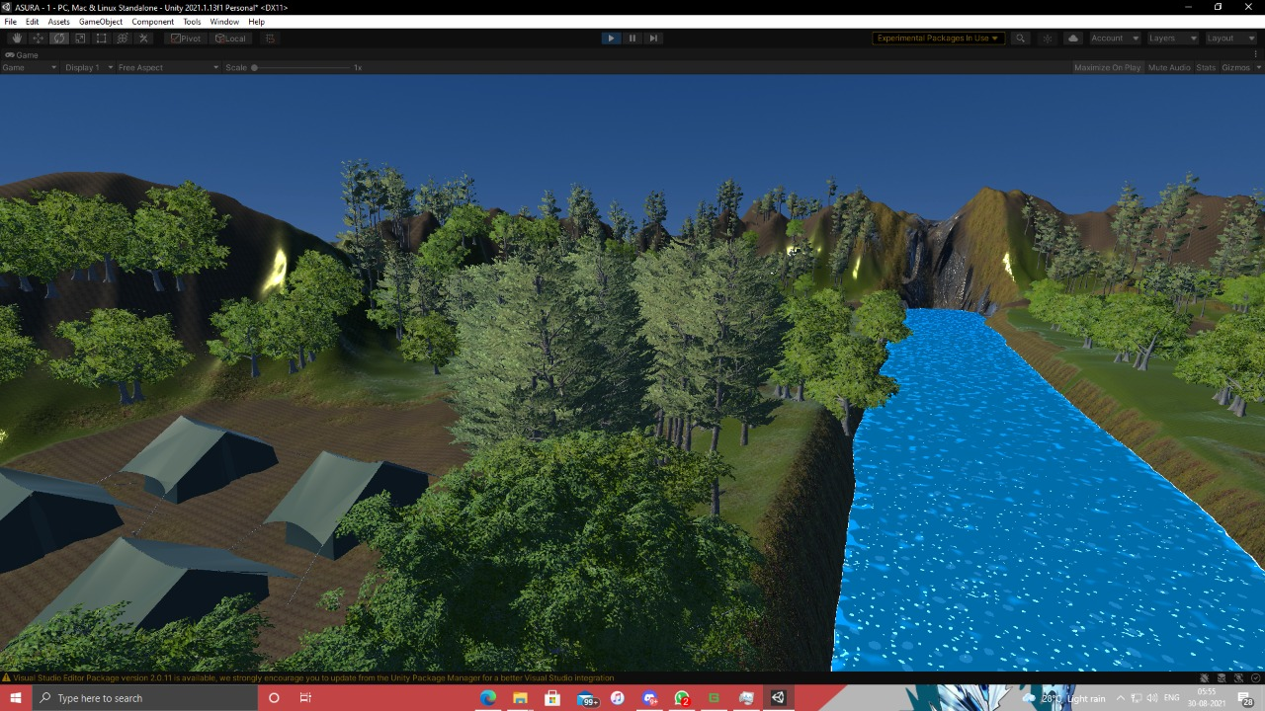
7. Prototype Design Demonstration

Slide 10
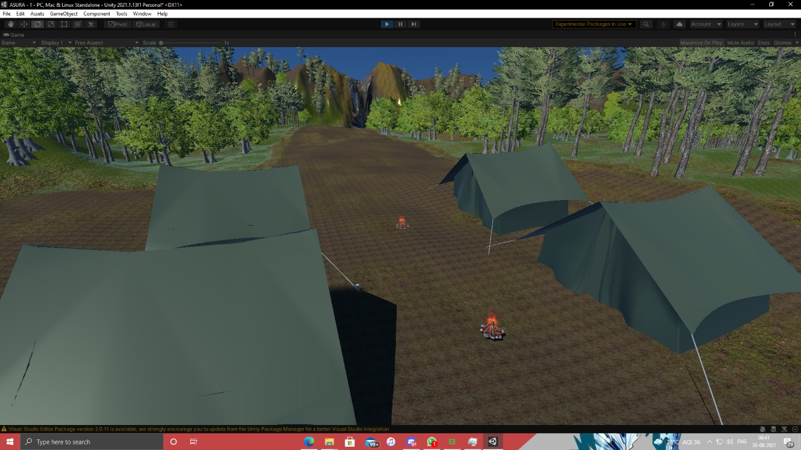

Slide 11
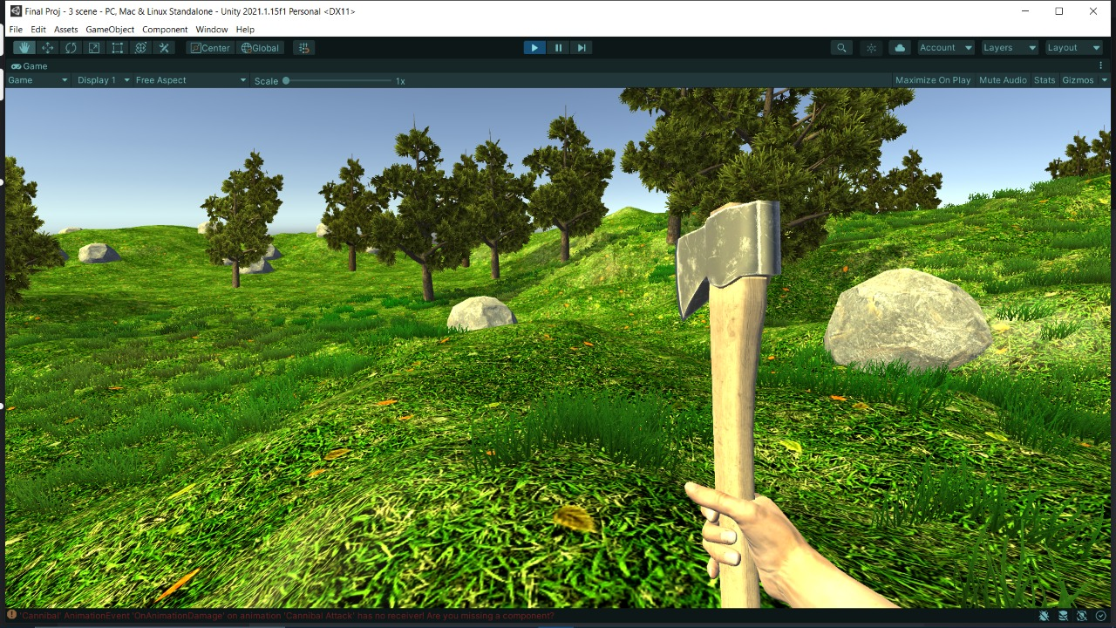

Slide 12
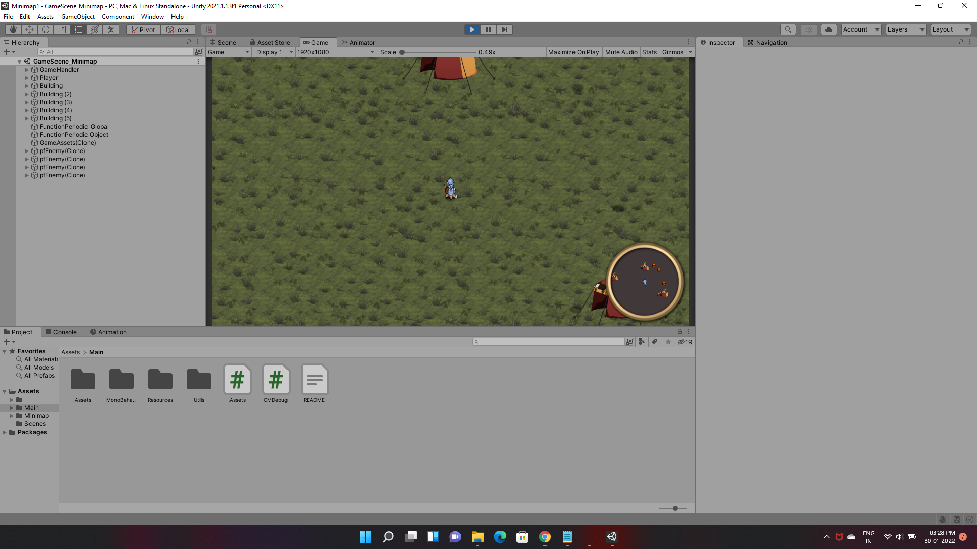

Slide 13
8. Implementation Status
1. Done with 1st level scene
2. Done with player and enemy script
3. Done with the player health bar system
4. Done with the Inventory GUI
5. Done with the cutscenes
6. Done with the minimap
7. Working on level 2 and level 3

Slide 14
9. Status of paper draft and targeted conference
Research paper has been approved by guide and submitted in IEEE conference.

Slide 15
Thank You...!!

